Slide 1
Team Lawrencium
Telerik Teamwork

Slide 2
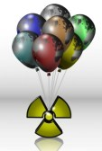
Balloons pop - 6

Slide 3
our team
Velizar Velizarov
Georgi Georgiev
Ognyan Petkov
Yanko Nazlamov - did not participate

